Slide 1
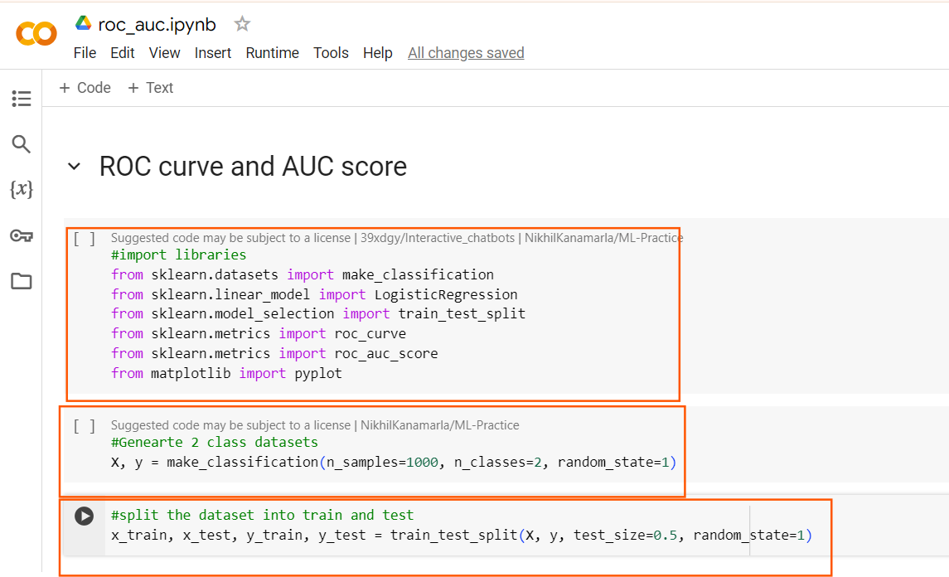

Slide 2
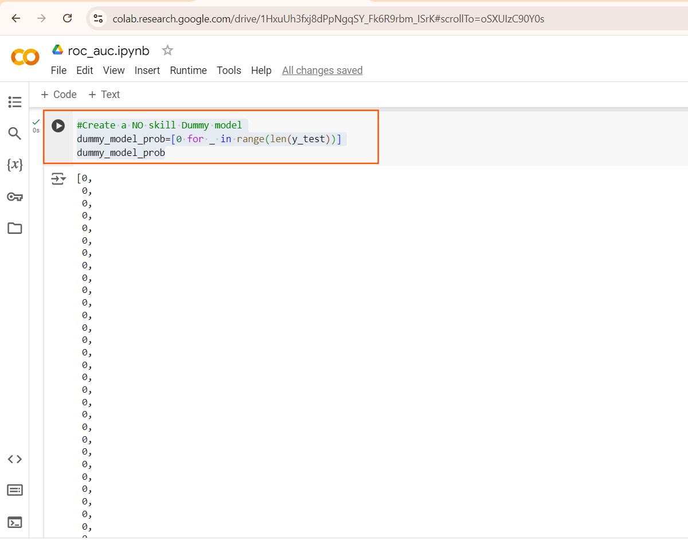

Slide 3
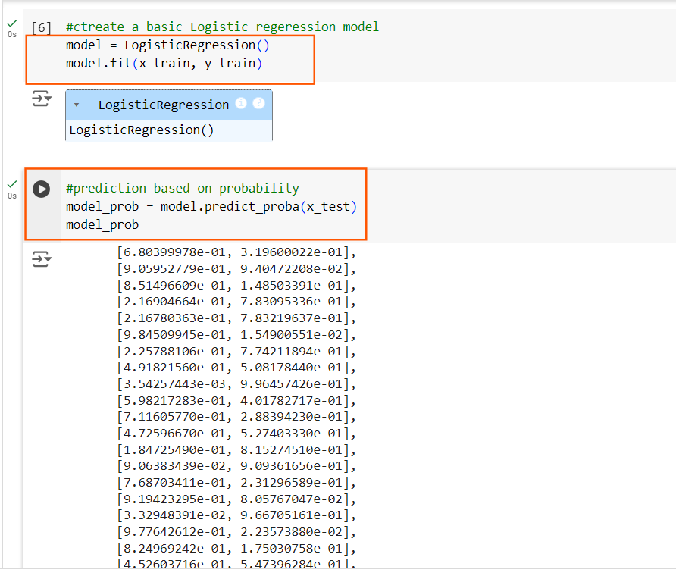
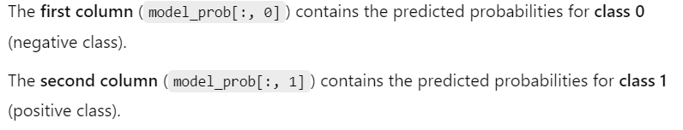
This is the probability of both positive and Negative class
i.e 0 and 1

Slide 4
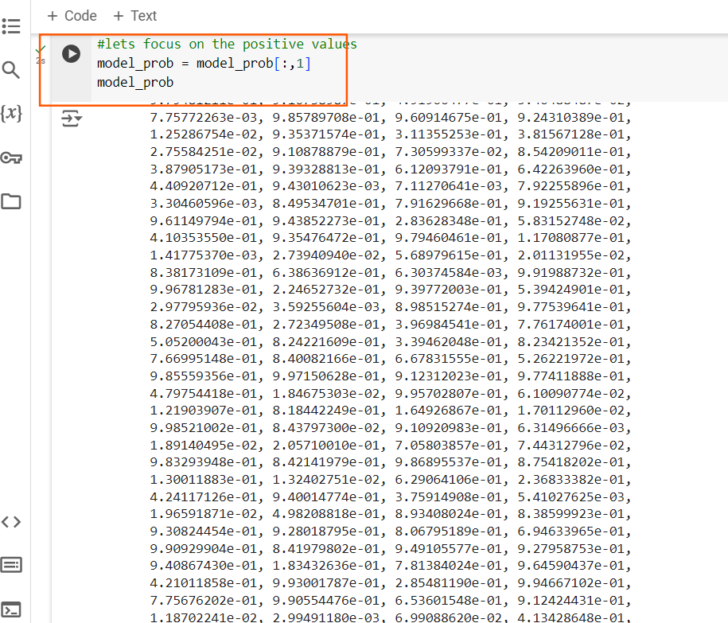
This is the probability of only positive values 1

Slide 5
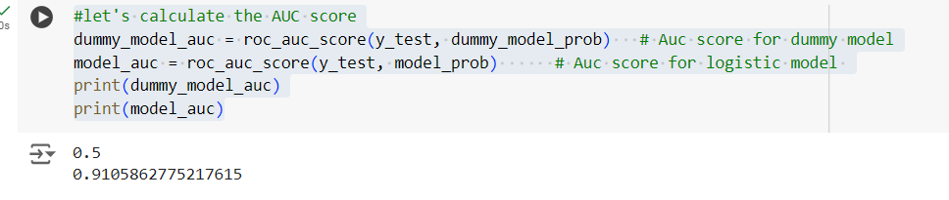
dummy_model_auc: Since this model is not learning any patterns, the AUC score will typically be around 0.5
model_auc :If this model is performing well, the AUC score should be greater than 0.5 and ideally close to 1.0

Slide 6
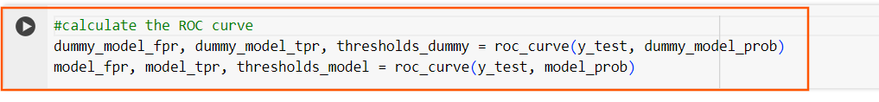
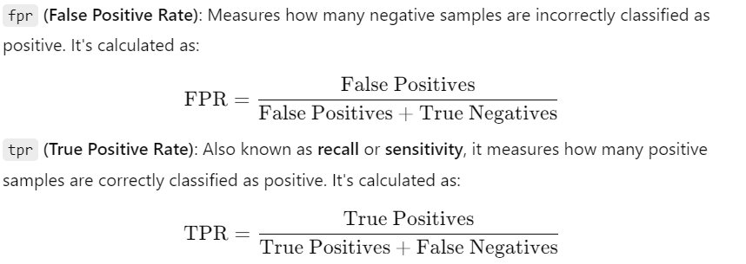
thresholds-dummy: The threshold at which the FPR and TPR are computed.
These thresholds are typically used for classification at different points on the ROC curve.

Slide 7
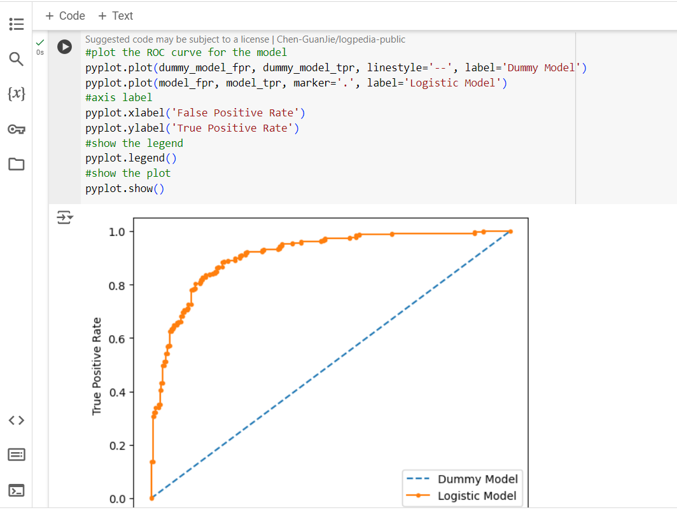
A model whose ROC curve is closer to the top-left corner indicates that it has a high True Positive Rate (high sensitivity) and a low False Positive Rate (low fall-out)

Slide 8
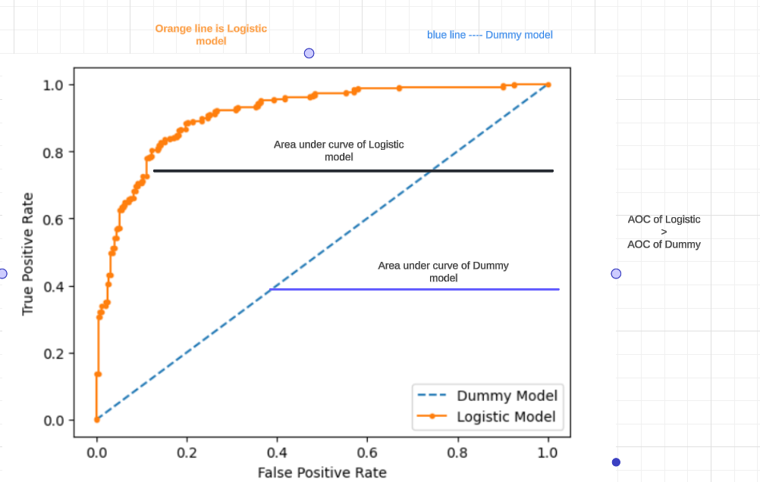
The model with the highest AUC is considered to perform the best overall across all thresholds.

